Slide 1
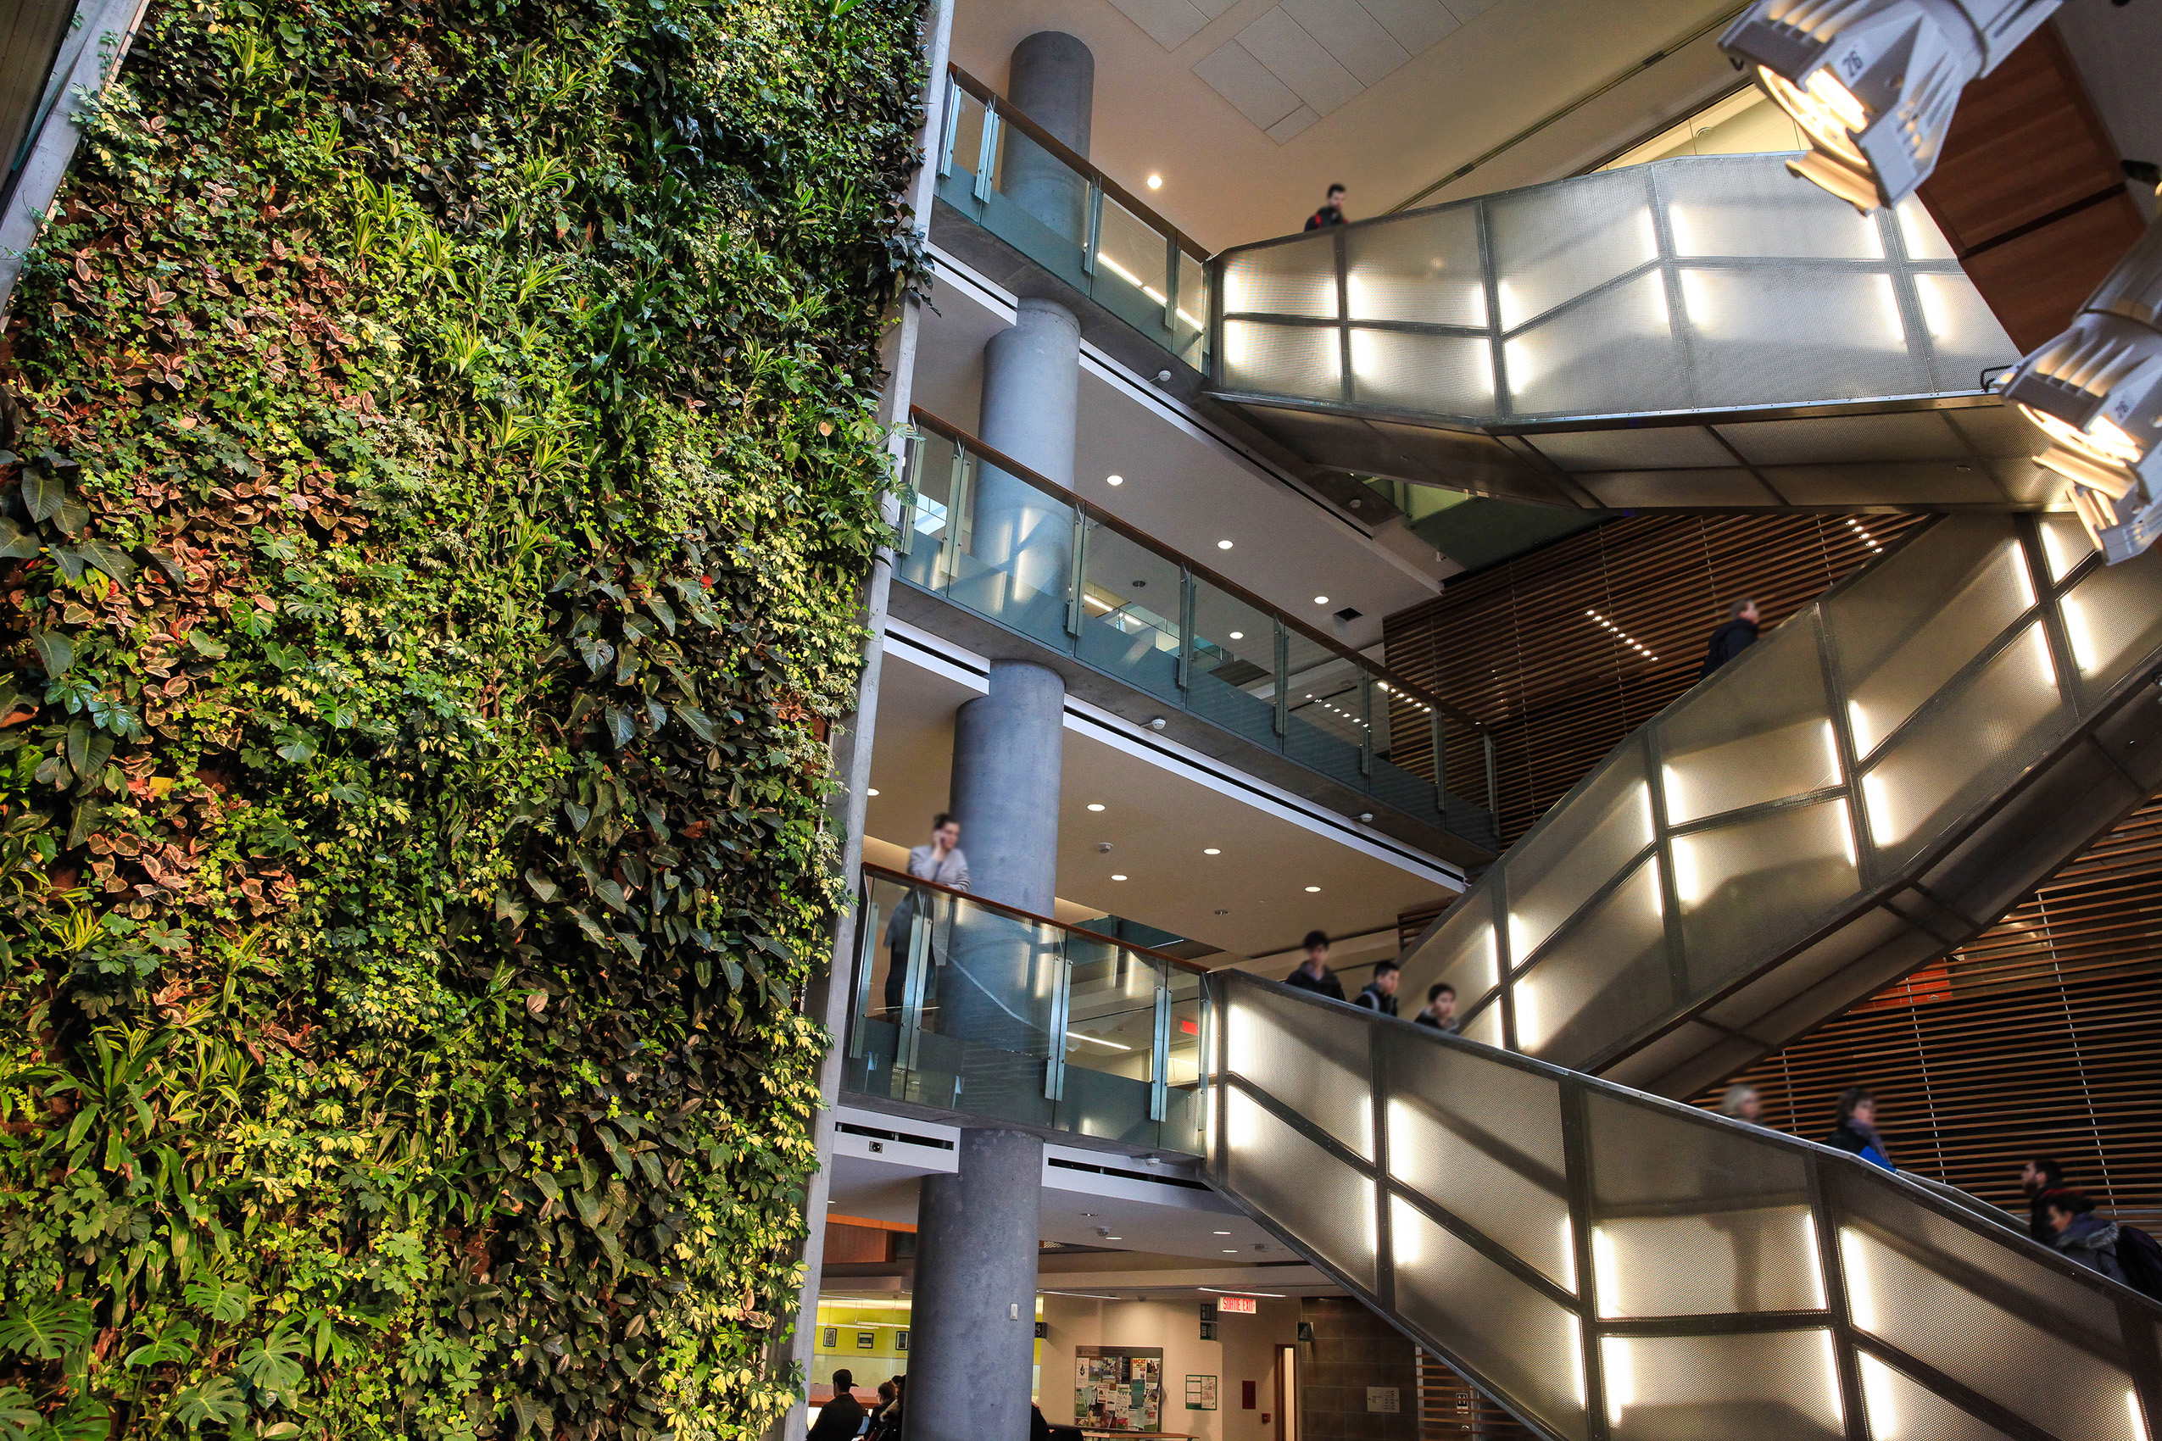

ELG 5163 – Machine Vision
Project Presentation
Inter-vehicle distance estimation using displaced stereo vision
Presented by: Alfa Budiman, Mathieu Falardeau Date: 31/03/2022
Faculté de génie | Faculty of Engineering
uOttawa.ca
Notes:
PAGE COUVERTURE (option 1) ÉBAUCHE (DOCUMENT NON FINALISÉ) À lire avant d’utiliser le gabarit
NOTE : Les éléments du gabarit suivants ne peuvent être modifiés : • Entête organisationnelle grenat (Université d’Ottawa | University of Ottawa) • Pied de page organisationnel comprenant la bande grise et violet foncé ainsi que le logo, à l’exception de l’adresse Web qui peut être modifiée en suivant les étapes suivantes : dans le document PowerPoint, cliquez sur l’onglet View, puis sélectionnez Slide Master. Sur le menu d’affichage (à gauche), sélectionnez la troisième diapositive et inscrivez la nouvelle adresse sur celle-ci.
COVER PAGE (option 1)
DRAFT ONLY (FILE NOT FINAL) Read before using template
NOTE: The following elements of the template should remain untouched and cannot be modified:
• Corporate (Université d'Ottawa | University of Ottawa) garnet header
• Corporate uOttawa footer including the grey/dark purple stripe and logo, with the exception of the URL which can be customized to a specific URL by following these simple steps: On the PowerPoint View tab, in the Master Views group, select Slide Master. Select the third slide on the left side panel, and type in the desired URL on the slide.

Slide 2
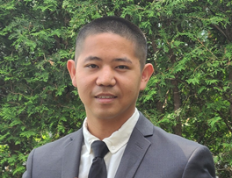
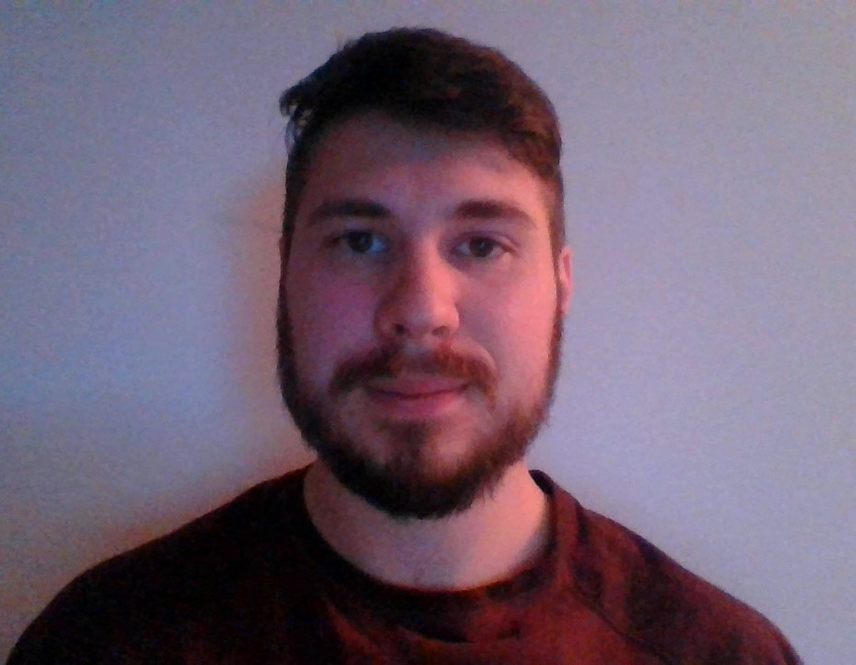
1
Alfa Budiman abudi097@uottawa.ca
Mathieu Falardeau mfala097@uottawa.ca

Slide 3

Aim
2
Present our ELG 5163 Machine vision term project and provide insight on a different approach to traditional stereo vision methods.

Slide 4
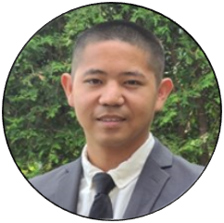
Outline
3
Introduction
Problem Description
Systems Used
Methodology:
Object Detection
Direction Calculation
Distance Calculation #1
Distance Calculation #2
Test & Results
Discussion and Conclusion

Slide 5
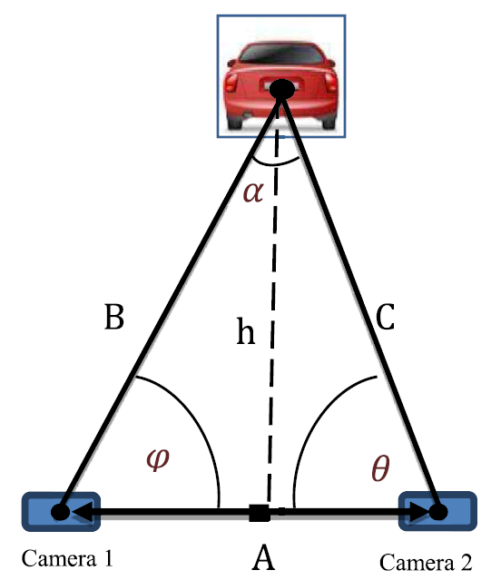
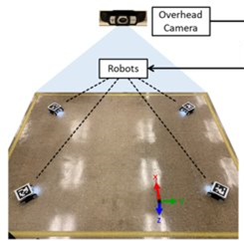
Introduction
4
Different methods to determine inter-vehicle distance:
Overhead Camera
Stereo vision

Slide 6
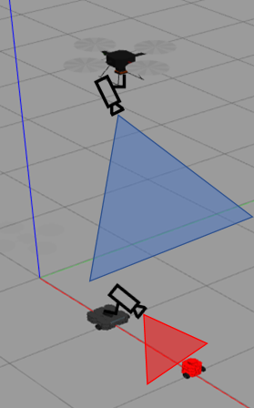
Problem Description
5
Weakness of those methods:
Overhead camera: Only 2D planar distance
Stereo vision: Two cameras per robot, increase cost
Proposed solution: Displaced stereo vision
Two image source:
Overhead camera
Ground camera
Detect desired object
Calculate 2 x vector direction
Calculate distance

Slide 7





Systems Used (Software)(1/2)
6
Robot Operating System (ROS):
Open-source robotics middleware suite
Gazebo simulator:
open-source 3D robotics simulator
Programming Language:
Python
Libraries:
OpenCV, Numpy

Slide 8
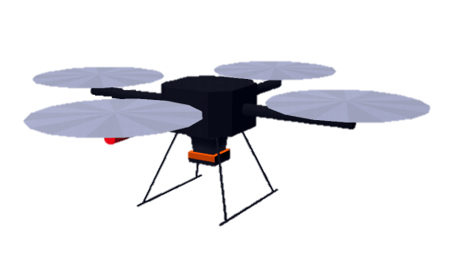
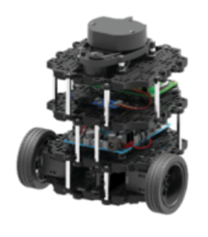
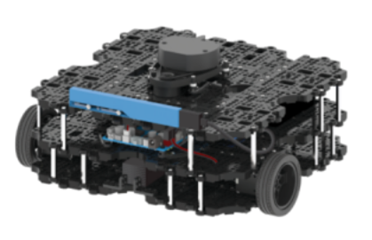
Systems Used (Robots) (2/2)
7
Hector Quad Rotor
(quadcopter)
Turtlebot3 Waffle
(wafflebot)
Turtlebot3 Burger
(burgerbot)

Slide 9
Methodology
8
Object Detection and Feature Matching
Detect red pixels on burgerbot and black pixels on wafflebot
Direction Calculation
Calculate relative direction from respective cameras
Position Calculation
Quadcopter and wafflebot positions and orientation are known
Relative directions to burger bot are known
Distance Calculation
Difference between wafflebot and burgerbot positions
Notes:
Go over 4 step process of vision based distance estimation
Step 1 – object (a red burgerbot) is observed, detected and tracked from 2 cameras, one overhead on a quadcopter, and one mounted on a wafflebot.
Step 2 - the direction to the object from both observers is estimated as a unit vector by using the pixel coordinates of detected object
Step 3 – with the positions of observers known and direction (unit vector) to object known, the position of the object can be calculated,
Step 4 –enough info to calculate distance, the distance from the observers to the object is the difference between their positions

Slide 10
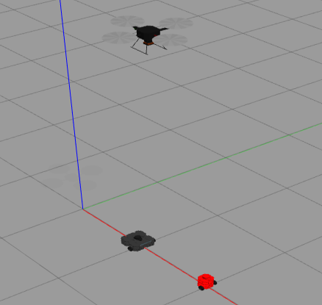
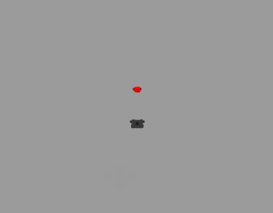
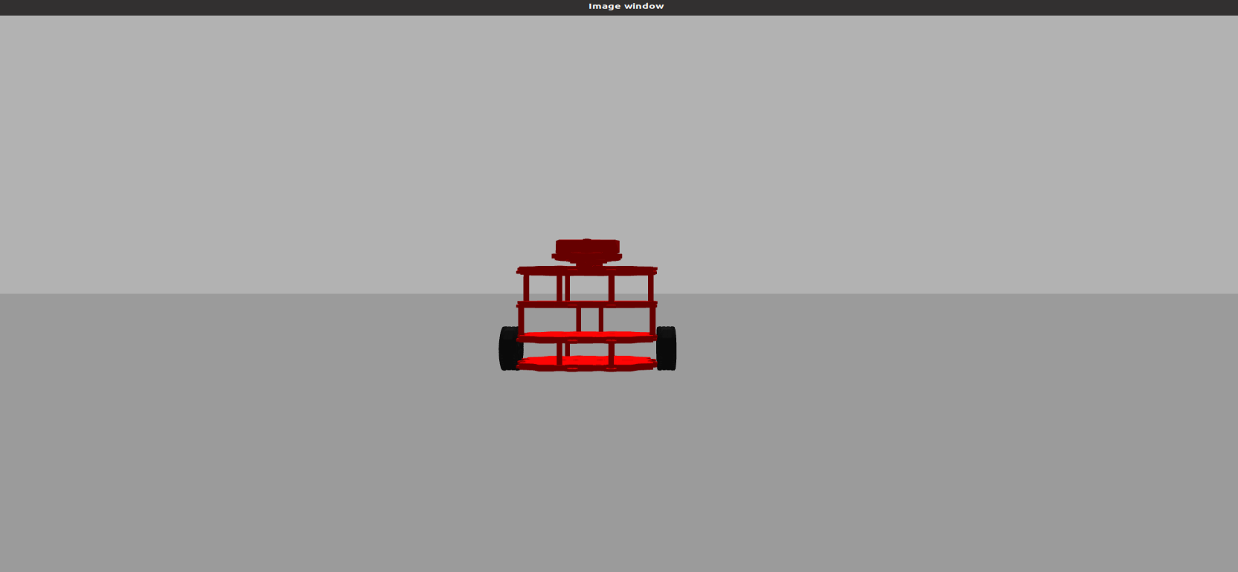
Object Detection and Feature Matching
9
Quadcopter camera
Wafflebot camera
Notes:
Object detection and feature matching
Quadcopter camera detected groups of black pixels and red pixels
Center of black pixels is wafflebot. Red pixel closet to center of black pixels is burgerbot
Wafflebot camera detected red pixels. Center of red pixels is burgerbot.

Slide 11
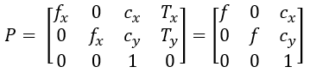
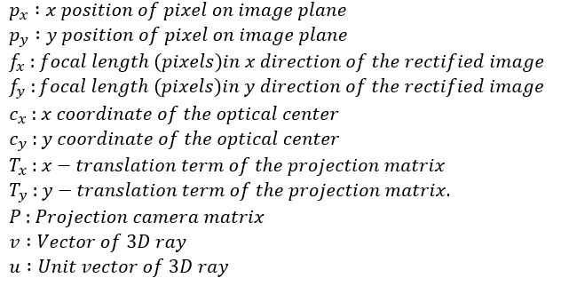
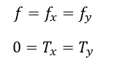
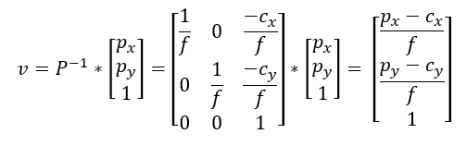
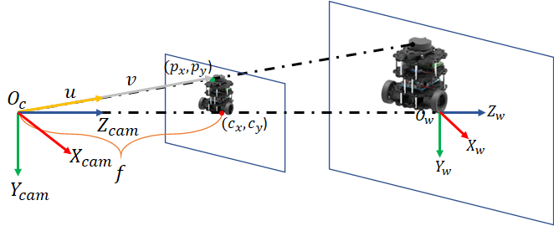
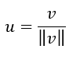
Direction Calculator (1/2)
10

Slide 12
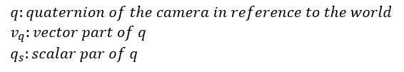
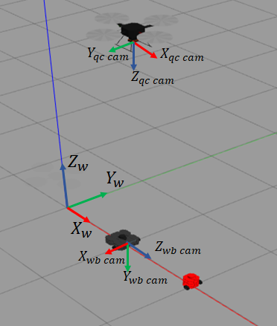
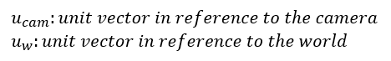
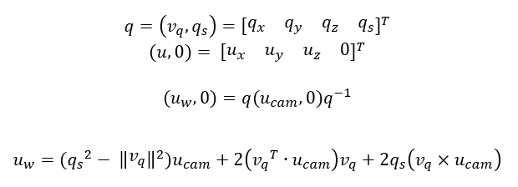
Direction Calculator (2/2)
11

Slide 13
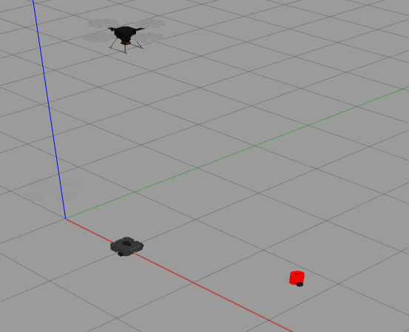
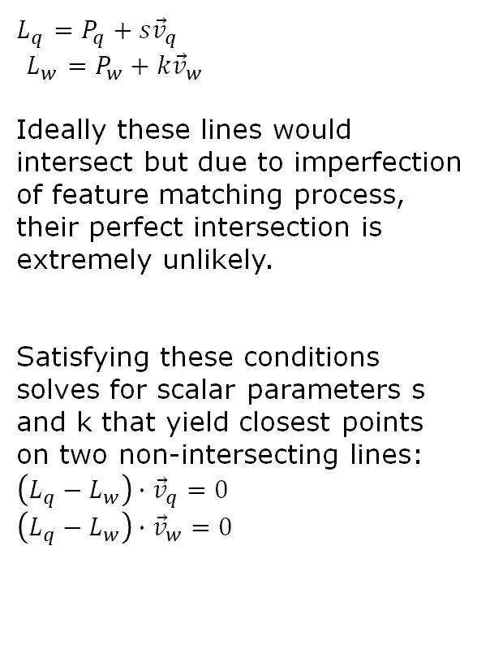
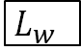
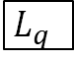
Distance Calculator 1
12
$L_{q}$ $=P_{q}+s{\vec{v}}_{q}$
$L_{w}$ $=P_{w}+k{\vec{v}}_{w}$
Ideally these lines would intersect but due to imperfection of feature matching process, their perfect intersection is extremely unlikely.
Satisfying these conditions solves for scalar parameters s and k that yield closest points on two non-intersecting lines:
$\left(L_{q}−L_{w}\right)∙{\vec{v}}_{q}=0$ $\left(L_{q}−L_{w}\right)∙{\vec{v}}_{w}=0$
$L_{q}$
$L_{w}$
Notes:
1 min 30 ish ish

Slide 14
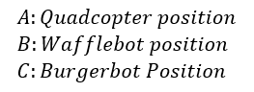
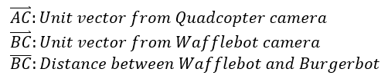
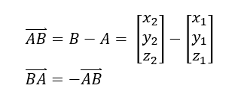
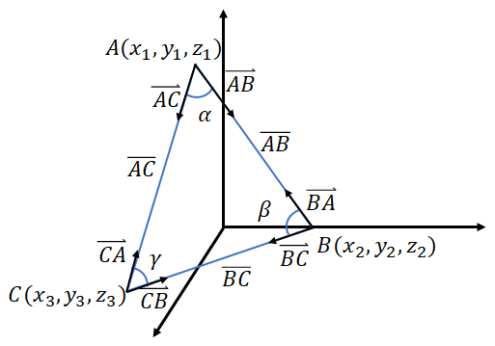
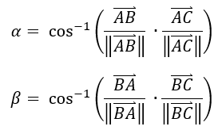
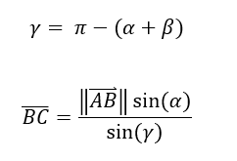
Distance Calculator 2
13

Slide 15
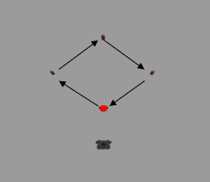
Test Drive
14
Burgerbot drove through 4 waypoints under observation from quadcopter and wafflebot.
Two scenarios:
Test 1 – stationary observer
Test 2 – leader / follower
Same burgerbot path in both tests

Slide 16

Test Drive - Stationary
15

Slide 17
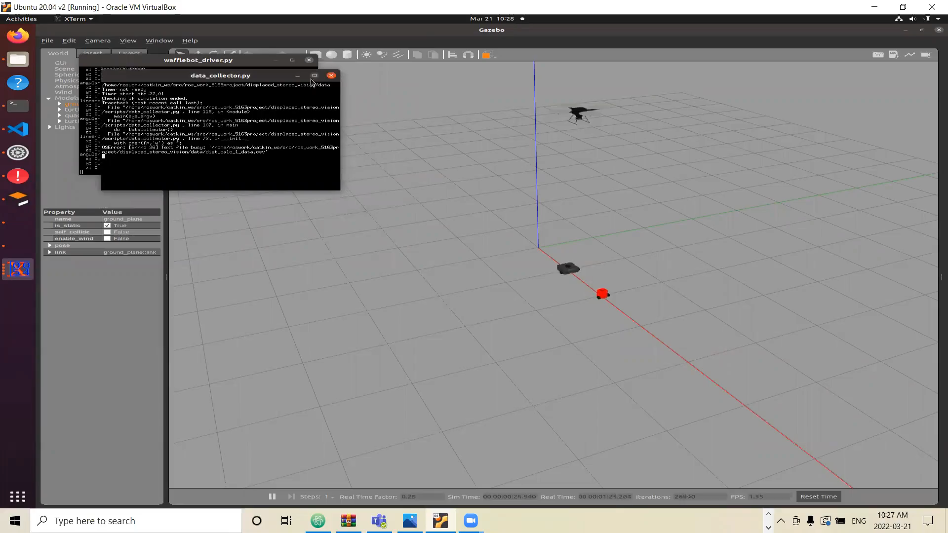
Test Drive – Leader Follower
16

Slide 18
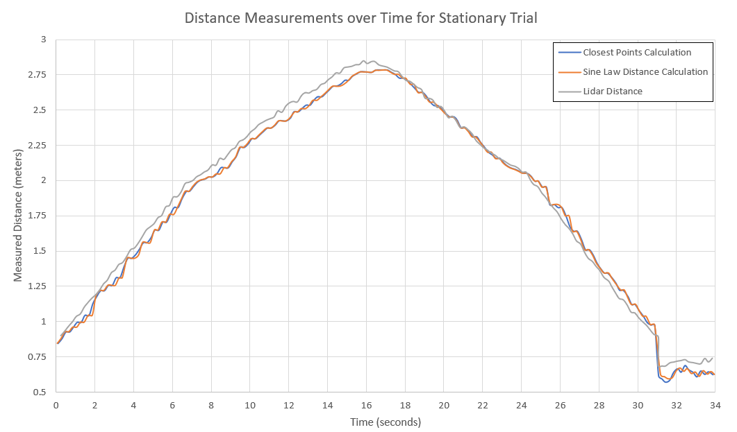
Results
17
Stationary Test
Image of path here
Re-do screen shot to change title
Notes:
- Good distance measurement between both vision based methods compared to lidar
Blue orange grey

Slide 19
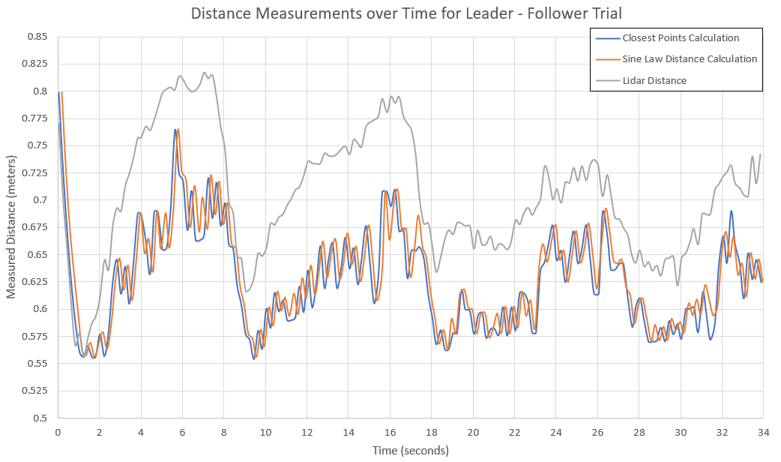
Results
18
Leader / Follower Test
Notes:
Distance measurement is good but starts to deviate when the wafflebot starts moving to catch up to the burgerbot
Error is less when wafflebot is stationary, which occurs when it is rotating to orient itself to face the burgerbot
- distances were relatively small so more sensitive to noise

Slide 20
Discussion
19
Applications:
Multi-robot path planning
Leader follower with obstructing obstacles
Distance measurement over uneven terrain (hills)
Further improvement
Improve robustness of object detection
Improve robustness of feature matching
Detection of different object types

Slide 21
Conclusion
20
Vision from a UGV and a UAV was combined to measure distance between a UGV and a moving object.
Effective for stationary UGV.
Requires further development on object detection and feature matching.

